Slide 1
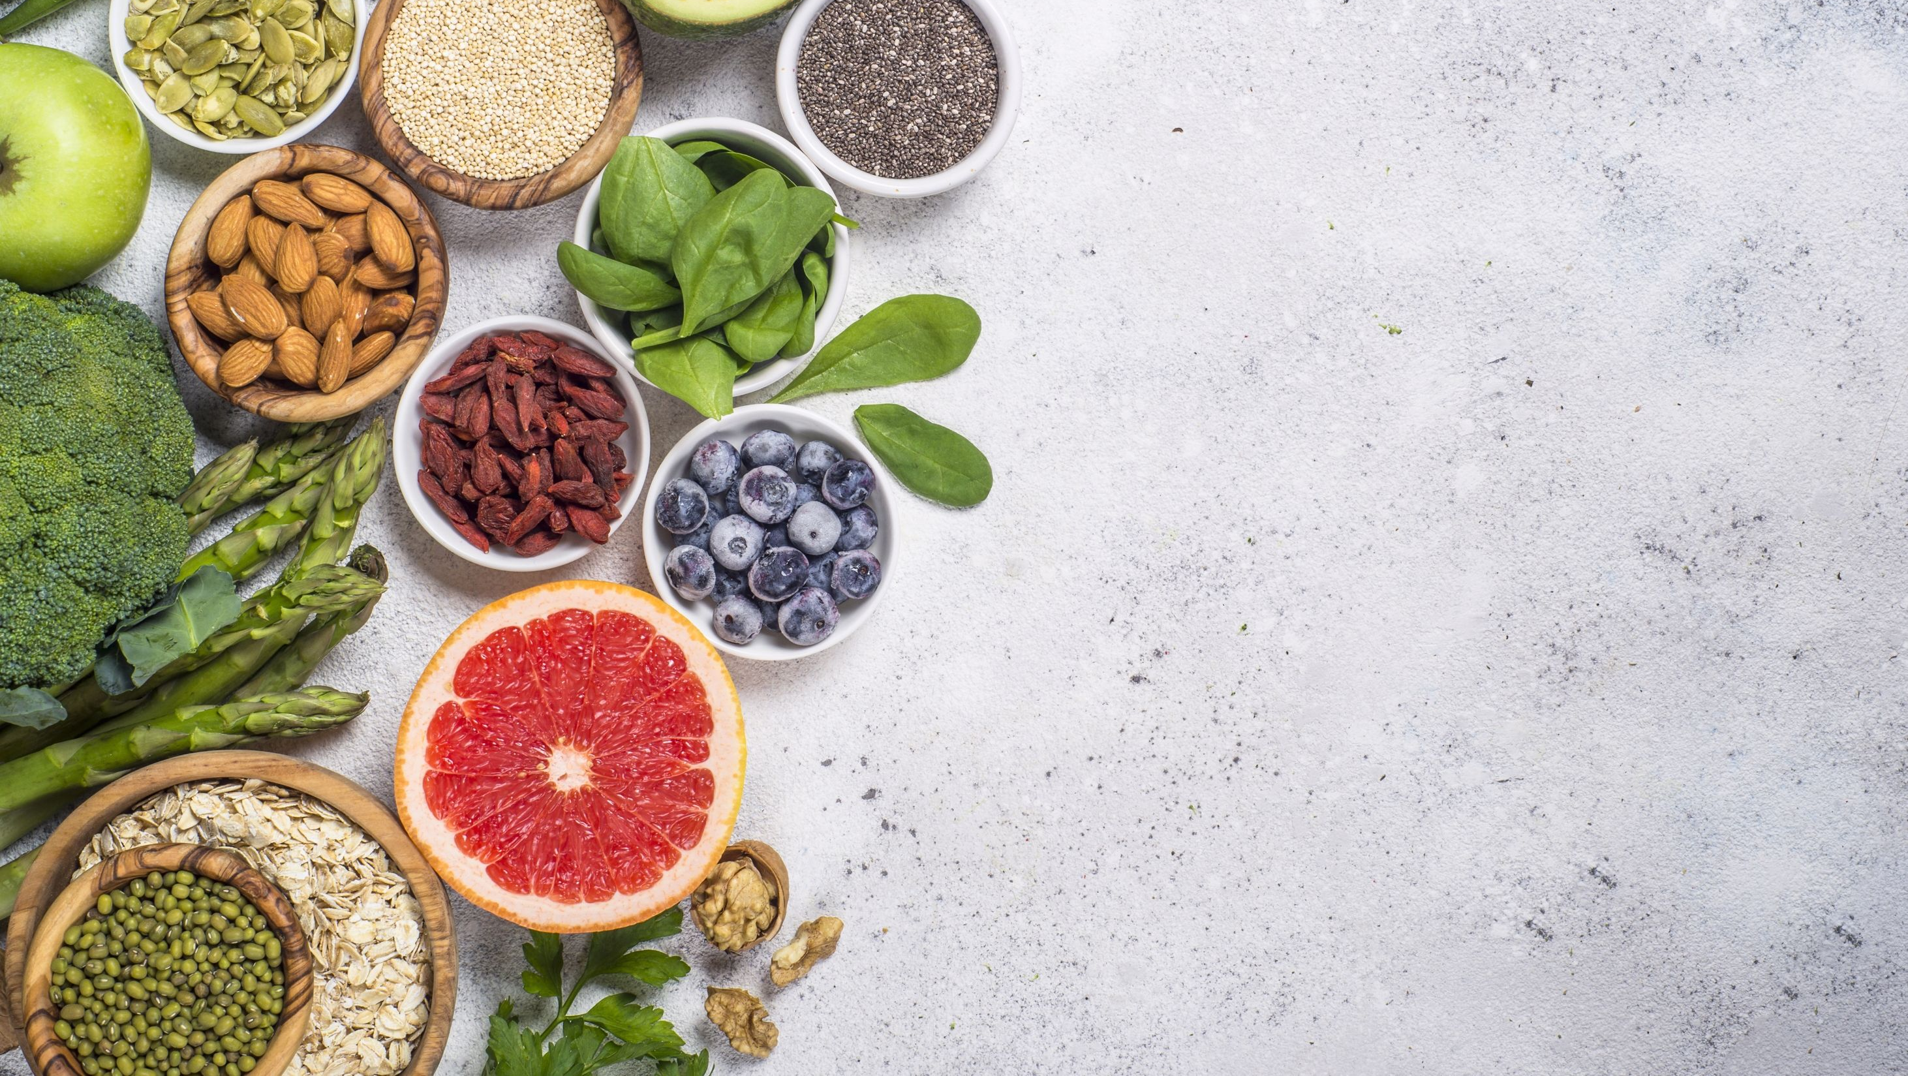
DESIGNED TO HELP VEGAN AND VEGAN-CURIOUS WOMEN KICKSTART THEIR WEIGHT LOSS
A WEEK OF PLANT-BASED EATING

